Slide 1
BLIND GUIDING DOG
BY
VASANTHAKUMAR A
VISHAL S
VISHNUDARSHAN S

Slide 2
Introduction:
Blindness makes life rather difficult for people who suffer from this health problem, but the use of technology can help in some day-to-day tasks.
In this context, the present work focuses the development of a photo-to-text-speech application for the blind. Intelligent Eye, as the name suggests, is a technical remedy for the visually impaired so that they can navigate themselves with their own self without external assistance.
Ideology behind this project is to strike an impact on the society so that visually backward beings can equalise their status.
In this project, we are going to use both image and text processing to build a useful deep learning application.

Slide 3
Motivation:
We must first understand how important this problem is to real world scenarios. Let’s see few applications where a solution to this problem can be very useful.
Self driving cars — Automatic driving is one of the biggest challenges and if we can properly caption the scene around the car, it can give a boost to the self driving system.
Aid to the blind — We can create a product for the blind which will guide them travelling on the roads without the support of anyone else. We can do this by first converting the scene into text and then the text to voice. Both are now famous applications of Deep Learning. Refer this link where its shown how Nvidia research is trying to create such a product.
CCTV cameras are everywhere today, but along with viewing the world, if we can also generate relevant captions, then we can raise alarms as soon as there is some malicious activity going on somewhere. This could probably help reduce some crime and/or accidents.
Automatic Captioning can help, make Google Image Search as good as Google Search, as then every image could be first converted into a caption and then search can be performed based on the caption.

Slide 4
PROBLEM STATEMENT:
Some time that information not easily get understood for that type of problem Image captioning is very useful. Our research problem is to accurately identify objects using neural networks and after using Computer vision and Natural Language Processing, language models captions are generated.
The main objective of the project is to describe the visual content in the form of text using image paragraph captioning by generating the textual description in terms of 4-5 sentences for the given input image using deep learning and Natural language processing techniques.

Slide 5
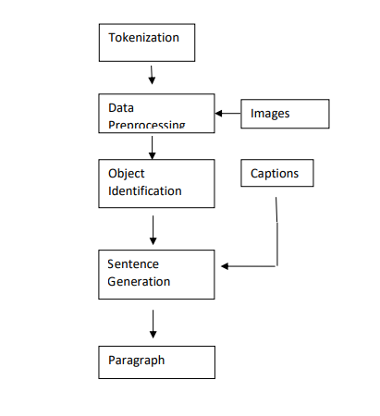
Proposed methodology:
Goal of image paragraph captioning is to generate descriptions from an image.This uses a
hierarchial approach for text generation.Firstly,the objects in the image are detected and a caption
related to that object is generated.Then combine the captions to get the output.
Tokenization is the first module in this work where character streams are divided into tokens which is
used in data(paragraph) preprocessing.It is the act of breaking up a sequence of strings into pieces such
as words,keywords,phrases,symbols and other elements called tokens.The tokens are stored in a afile
and used when needed

Slide 6
References
https://cs.stanford.edu/people/karpathy/cvpr2015.pdf
https://arxiv.org/abs/1411.4555
https://arxiv.org/abs/1703.09137
https://arxiv.org/abs/1708.02043
https://machinelearningmastery.com/develop-a-deep-learning-caption-generation-model-in-python/
https://www.youtube.com/watch?v=yk6XDFm3J2c
https://www.appliedaicourse.com/

Slide 7
THANK YOU

